Slide 1
Pathogens + Hygiene Indicators
In one single PCR reaction
Fecal Contamination Indicator
GMP Indicator
Salmonella
Listeria monocytogenes

Slide 2
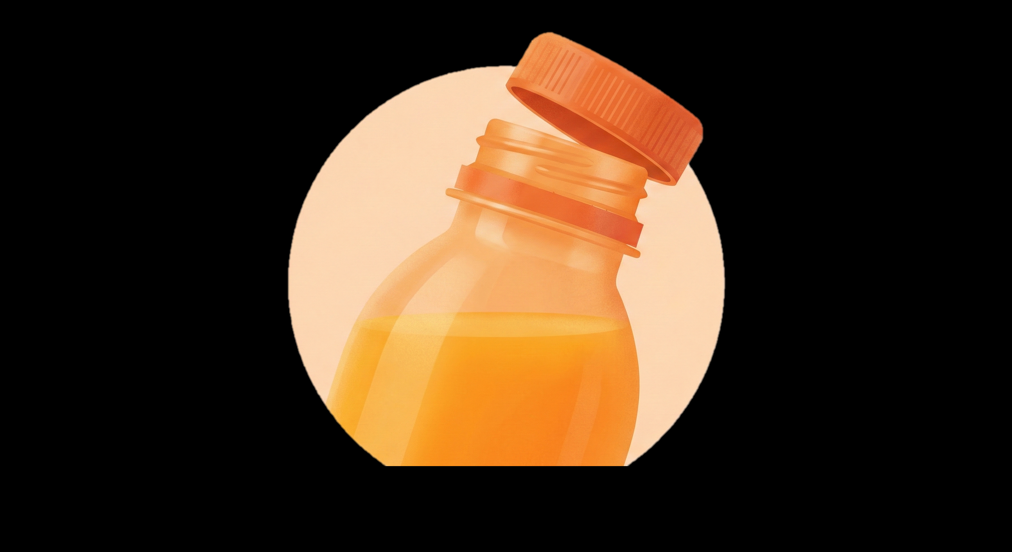
100+ acidophilic bacteria
100+ yeast & molds
Preservative resistant yeasts
Brettanomyces species

Slide 3

Salmonella
E. coli O157:H7
E. coli STEC

Slide 4

Results in ~8 hours
Salmonella

Slide 5
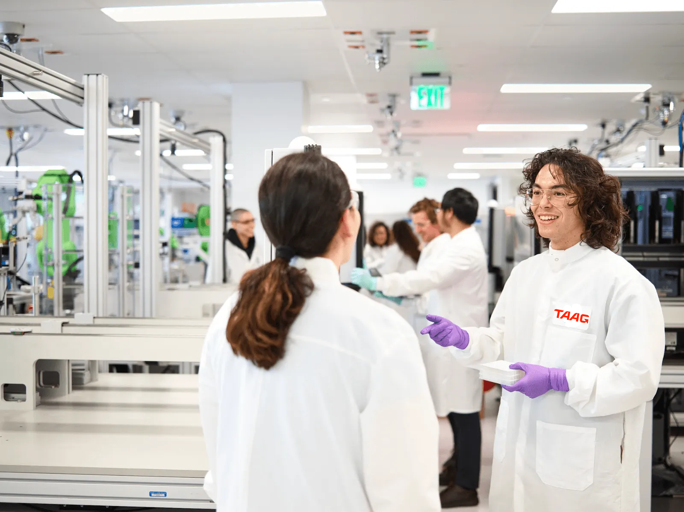
Indicators
E. coli
S. aureus
E. coli O157:H7
Spoilage
TxA
Listeria spp
Enterobacteria
L. monocytogenes
PRY
AiGOR
LABs
Molds
E. coli STEC
Yeasts
Salmonella

Slide 6
Indicators
S. aureus
E. coli
E. coli O157:H7
Spoilage
TxA
Listeria spp
Enterobacteria
L. monocytogenes
PRY
Molds
Salmonella
Yeasts
AiGOR
LABs
E. coli STEC

Slide 7


Slide 8
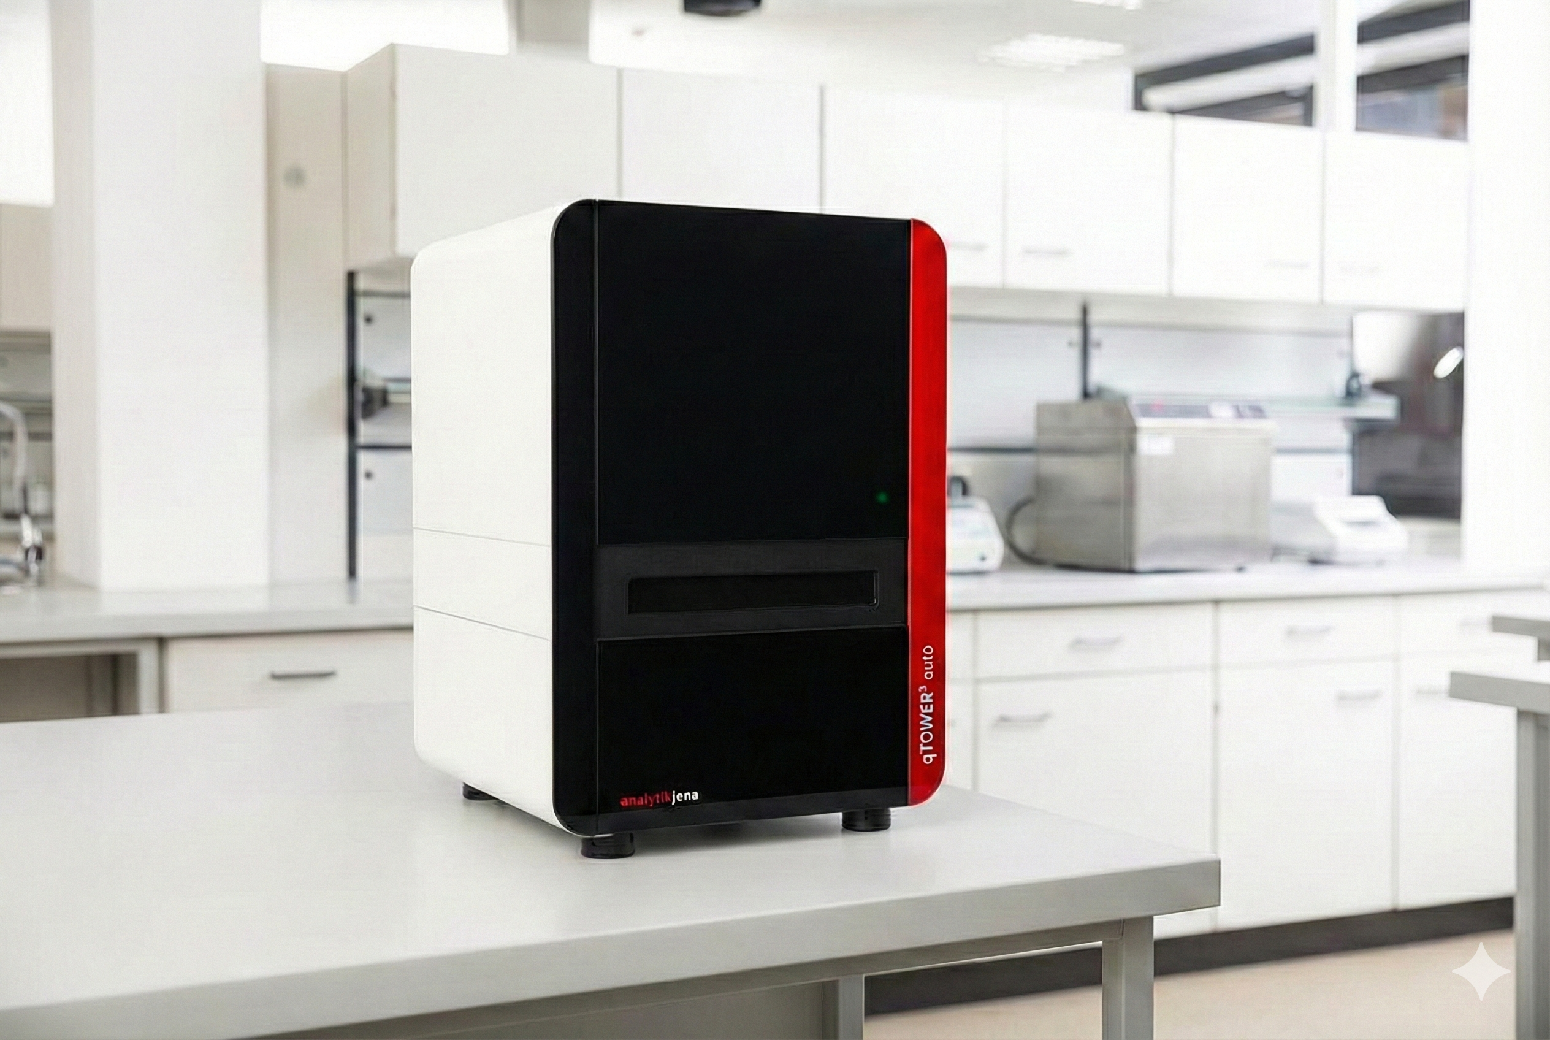

Slide 9
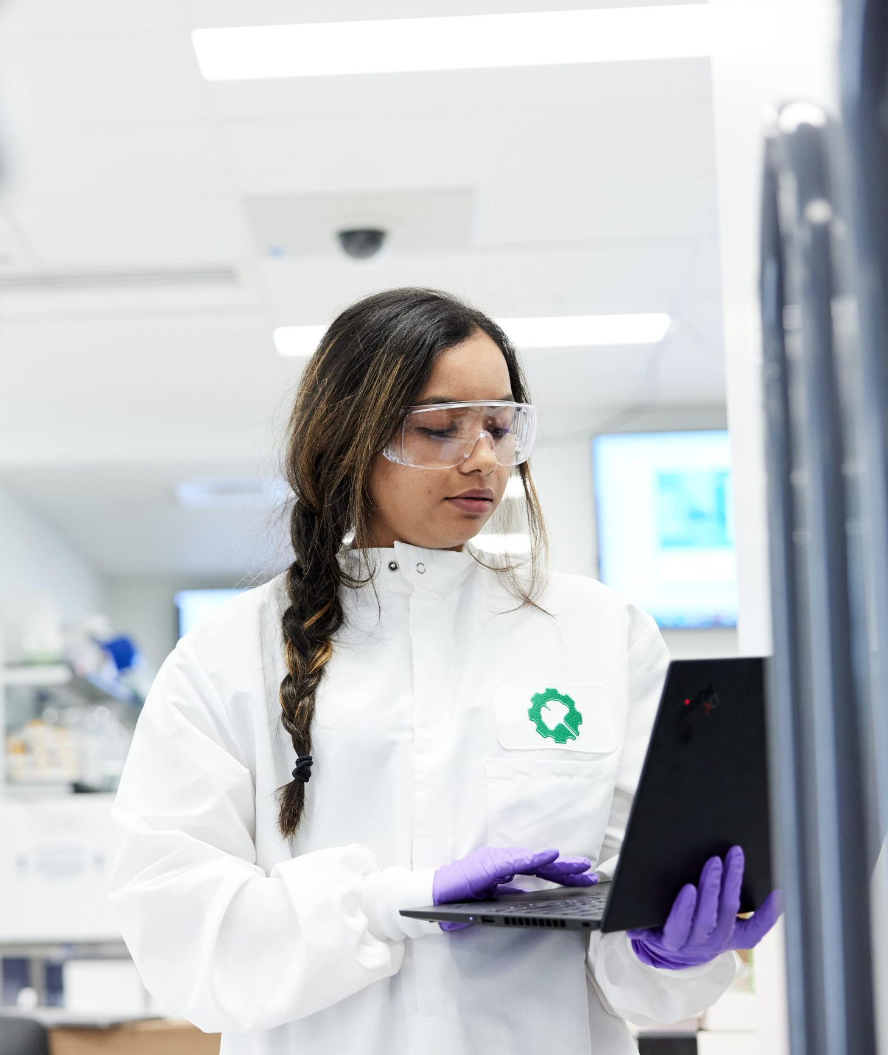


Slide 10
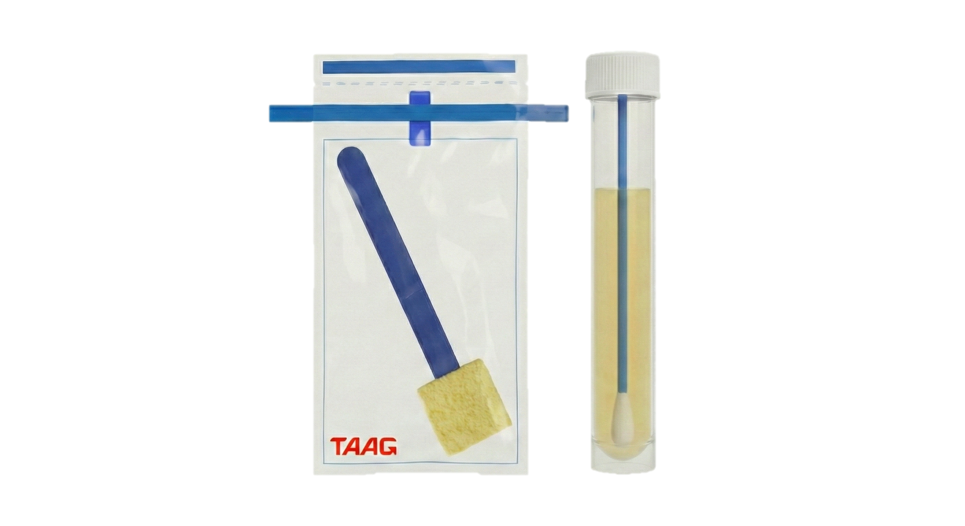

Slide 11
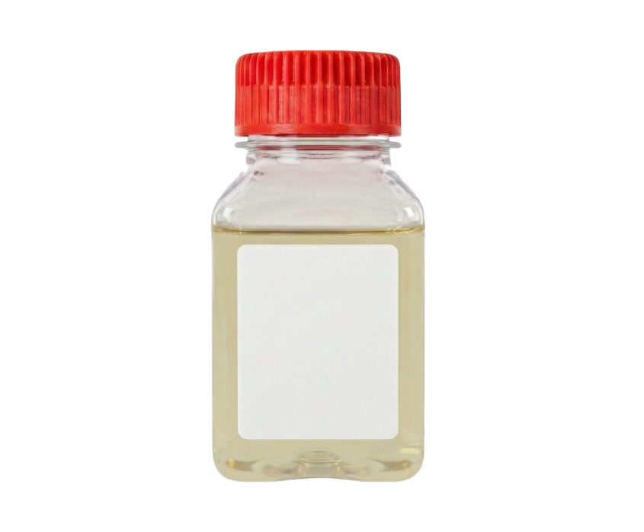
Universal Enrichment
Broth

Slide 12
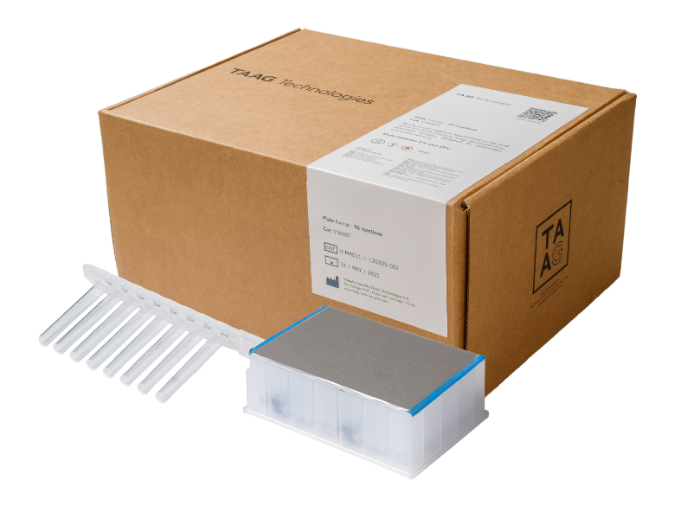

Slide 13
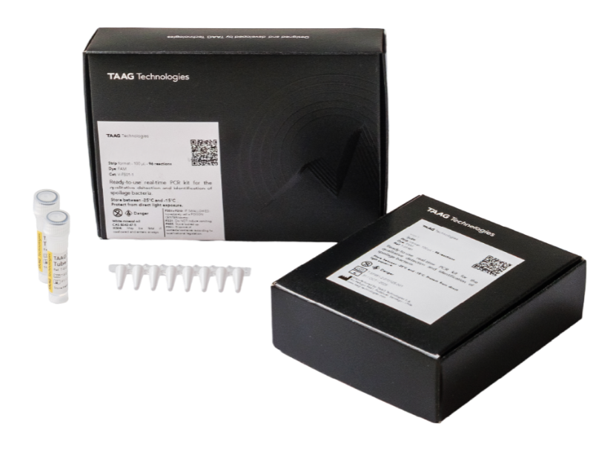

Slide 14
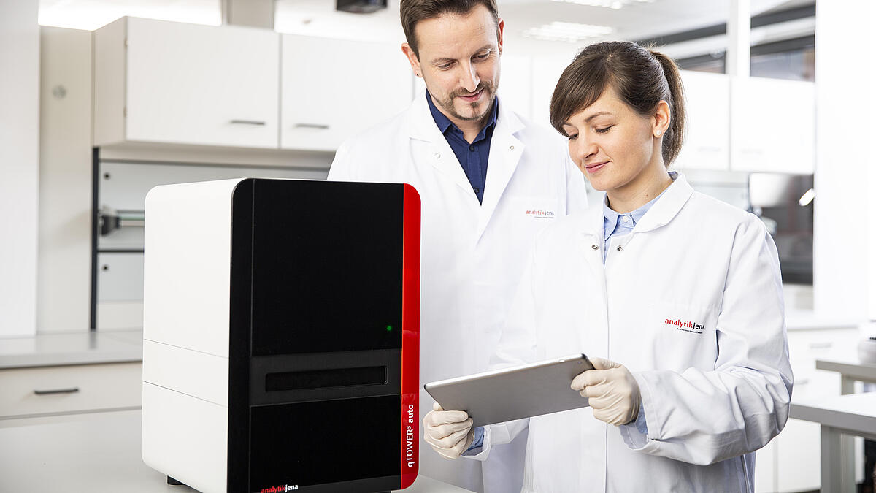

Slide 15
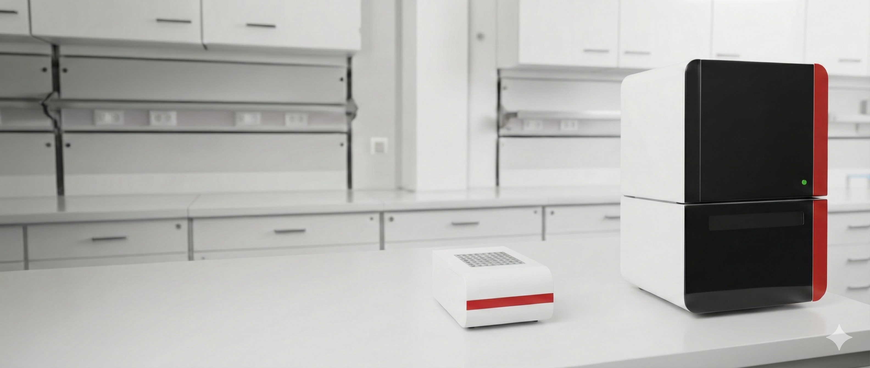

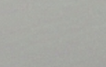

Slide 16
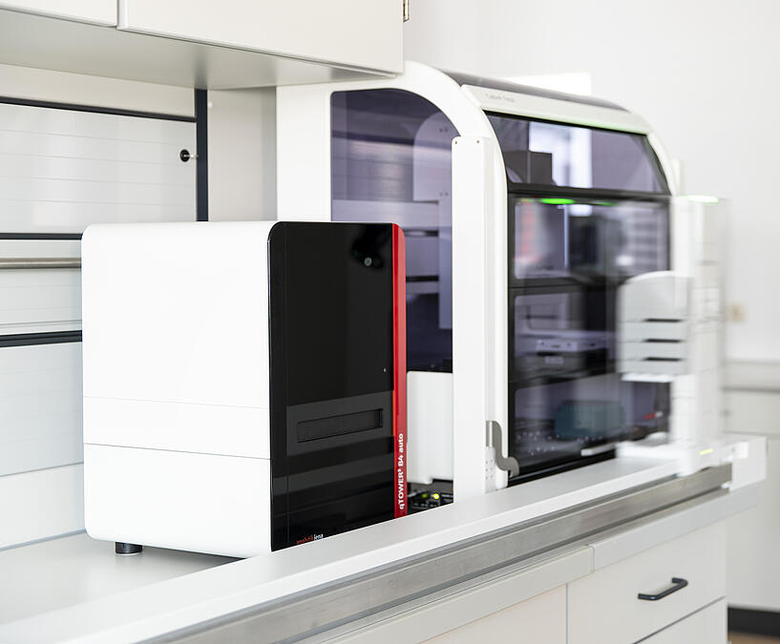

Slide 17
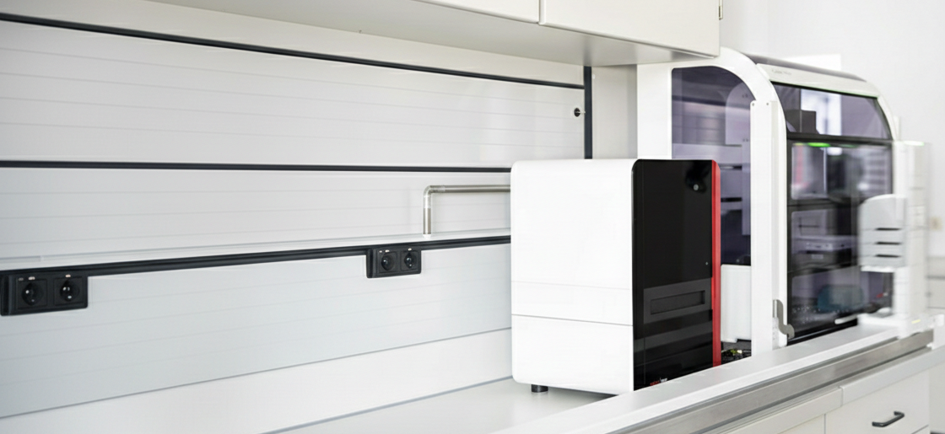

Slide 18

AiGOR™ technology
The first RNA-based detection technology that detects metabolically active microorganisms without waiting for long enrichments.
Results in
3-12
hours
with minimal hands-on time
10,000x
more sensitive than current real time PCR
1
CFU/sample
advanced RNA technology.

Slide 19
AiGOR™ technology
The first RNA-based detection technology that detects metabolically active microorganisms without waiting for long enrichments.
Results in
3-12
hours
with minimal hands-on time
10,000x
more sensitive than current real time PCR
1
CFU/sample
advanced RNA technology.

Slide 20
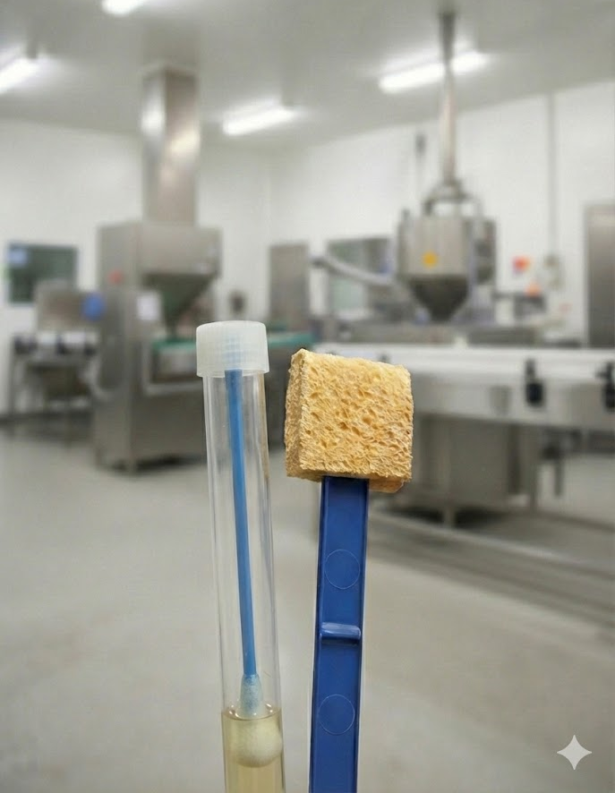

<3 hrs.
Total time to results
Protocol ZERO.
No enrichment.
Limit of detection:
1 CFU/swab

Slide 21
<3 hrs.
Total time to results
Protocol ZERO.
No enrichment.
Limit of detection:
1 CFU/swab

Slide 22
ZERO
Strategy
Ultrafast screening
Enrichment time
No enrichment
Total time to results
<3 hours
Intended use
Pre/post sanitation
Sampling device
Any swab
Limit of detection
1 CFU/sample
Downstream applications
None, destructive method. The whole sample must be processed

Slide 23
XPRESS
Strategy
Fast screening or routine EMP
Enrichment time
3 hr. enrichment
Total time to results
<6 hours
Intended use
Pre/post sanitation
Sampling device
Any swab and sponge
Limit of detection
1 CFU/sample
Downstream applications
Yes. Additional sample for downstream applications, ie. confirmation, WGS, etc.

Slide 24
XPRESS
Strategy
Fast screening or routine EMP
Enrichment time
3 hr. enrichment
Total time to results
<6 hours
Intended use
Pre/post sanitation
Sampling device
Any swab and sponge
Limit of detection
1 CFU/sample
Downstream applications
Yes. Additional sample for downstream applications, ie. confirmation, WGS, etc.

Slide 25
ZERO
Strategy
Ultrafast screening
Enrichment time
No enrichment
Total time to results
<3 hours
Intended use
Pre/post sanitation
Sampling device
Any swab
Limit of detection
1 CFU/sample
Downstream applications
None, destructive method. The whole sample must be processed

Slide 26
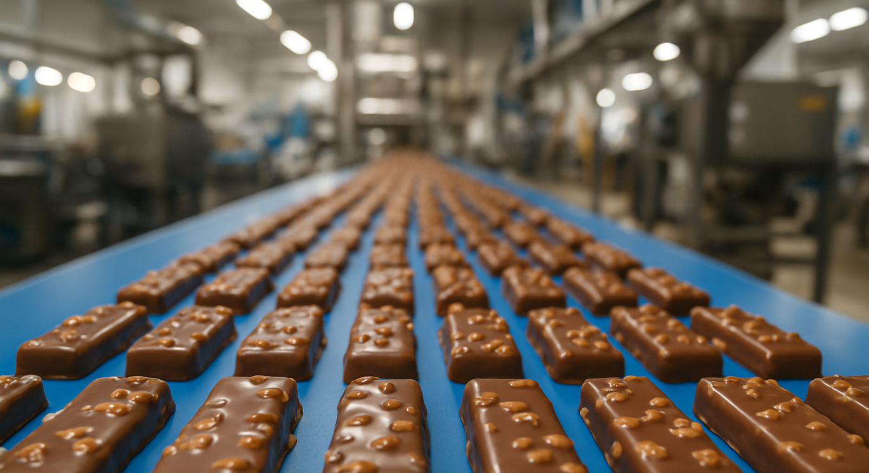
<3 hrs.
Total time to results
Liquid samples.
Limit of detection:
1 CFU/1 gr
<7 hrs.
Total time to results
Most food samples.
Limit of detection:
1 CFU/25 gr
<12 hrs.
Total time to results
Complex food samples.
Limit of detection:
1 CFU/25 gr or
1 CFU/375 gr

Slide 27
<3 hrs.
Total time to results
Liquid
samples.
Limit of detection:
1 CFU/1 gr
<7 hrs.
Total time to results
Most food samples.
Limit of detection:
1 CFU/25 gr
<12 hrs.
Total time to results
Complex food samples.
Limit of detection:
1 CFU/25 gr or
1 CFU/375 gr

Slide 28
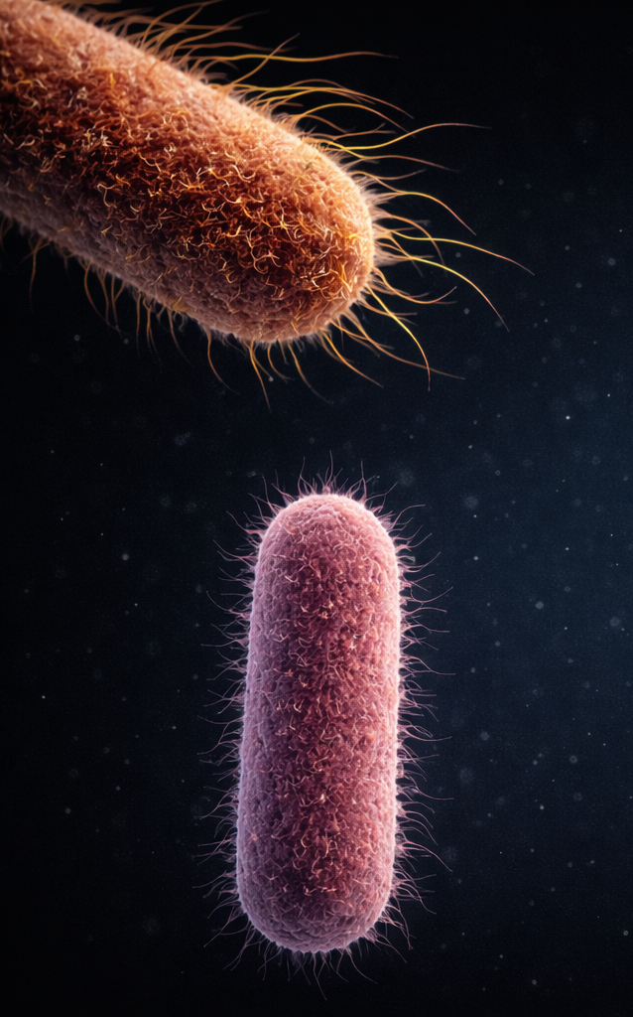

Slide 29
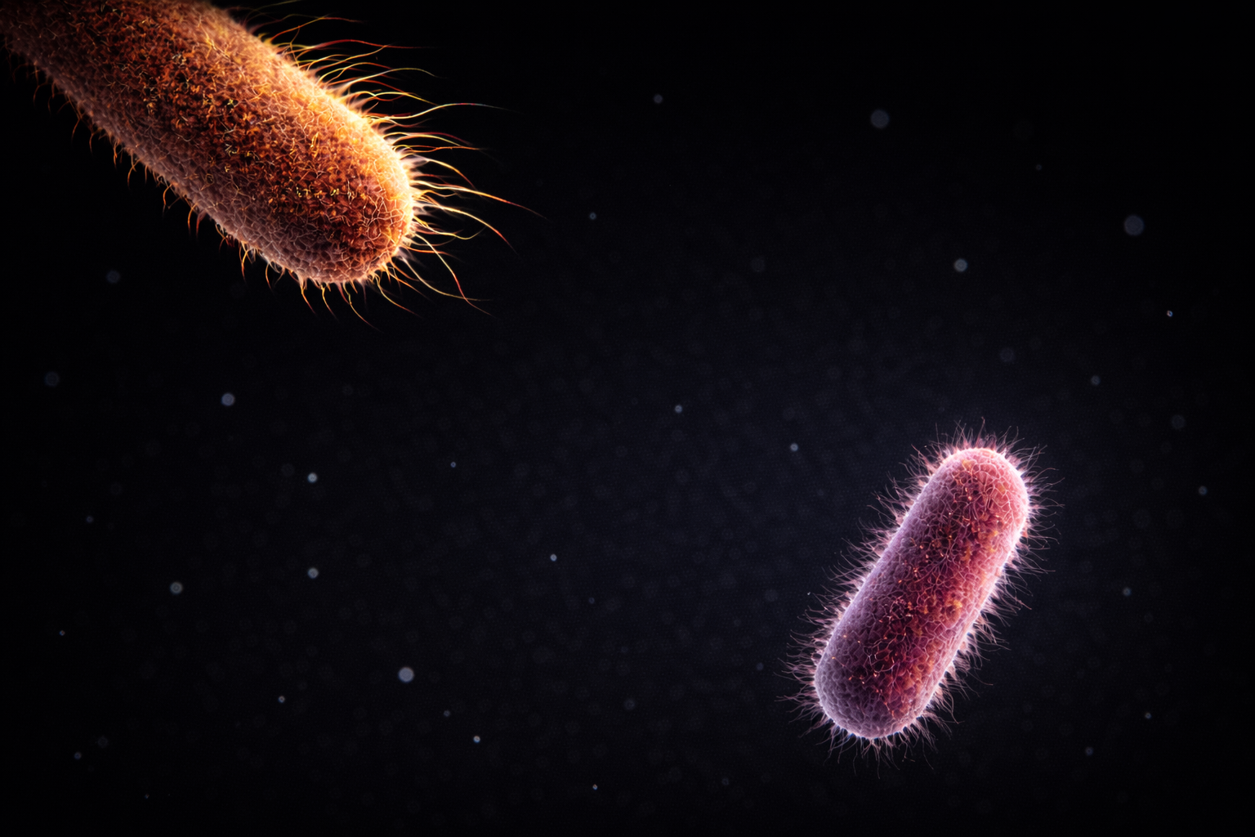

Slide 30
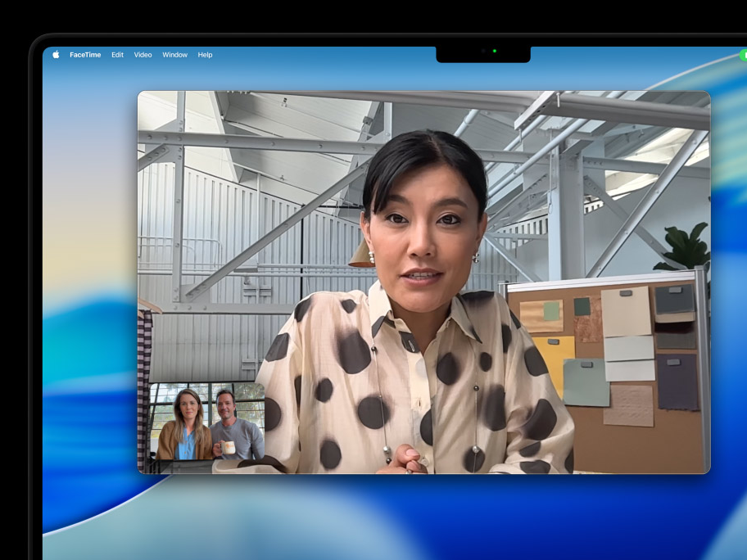

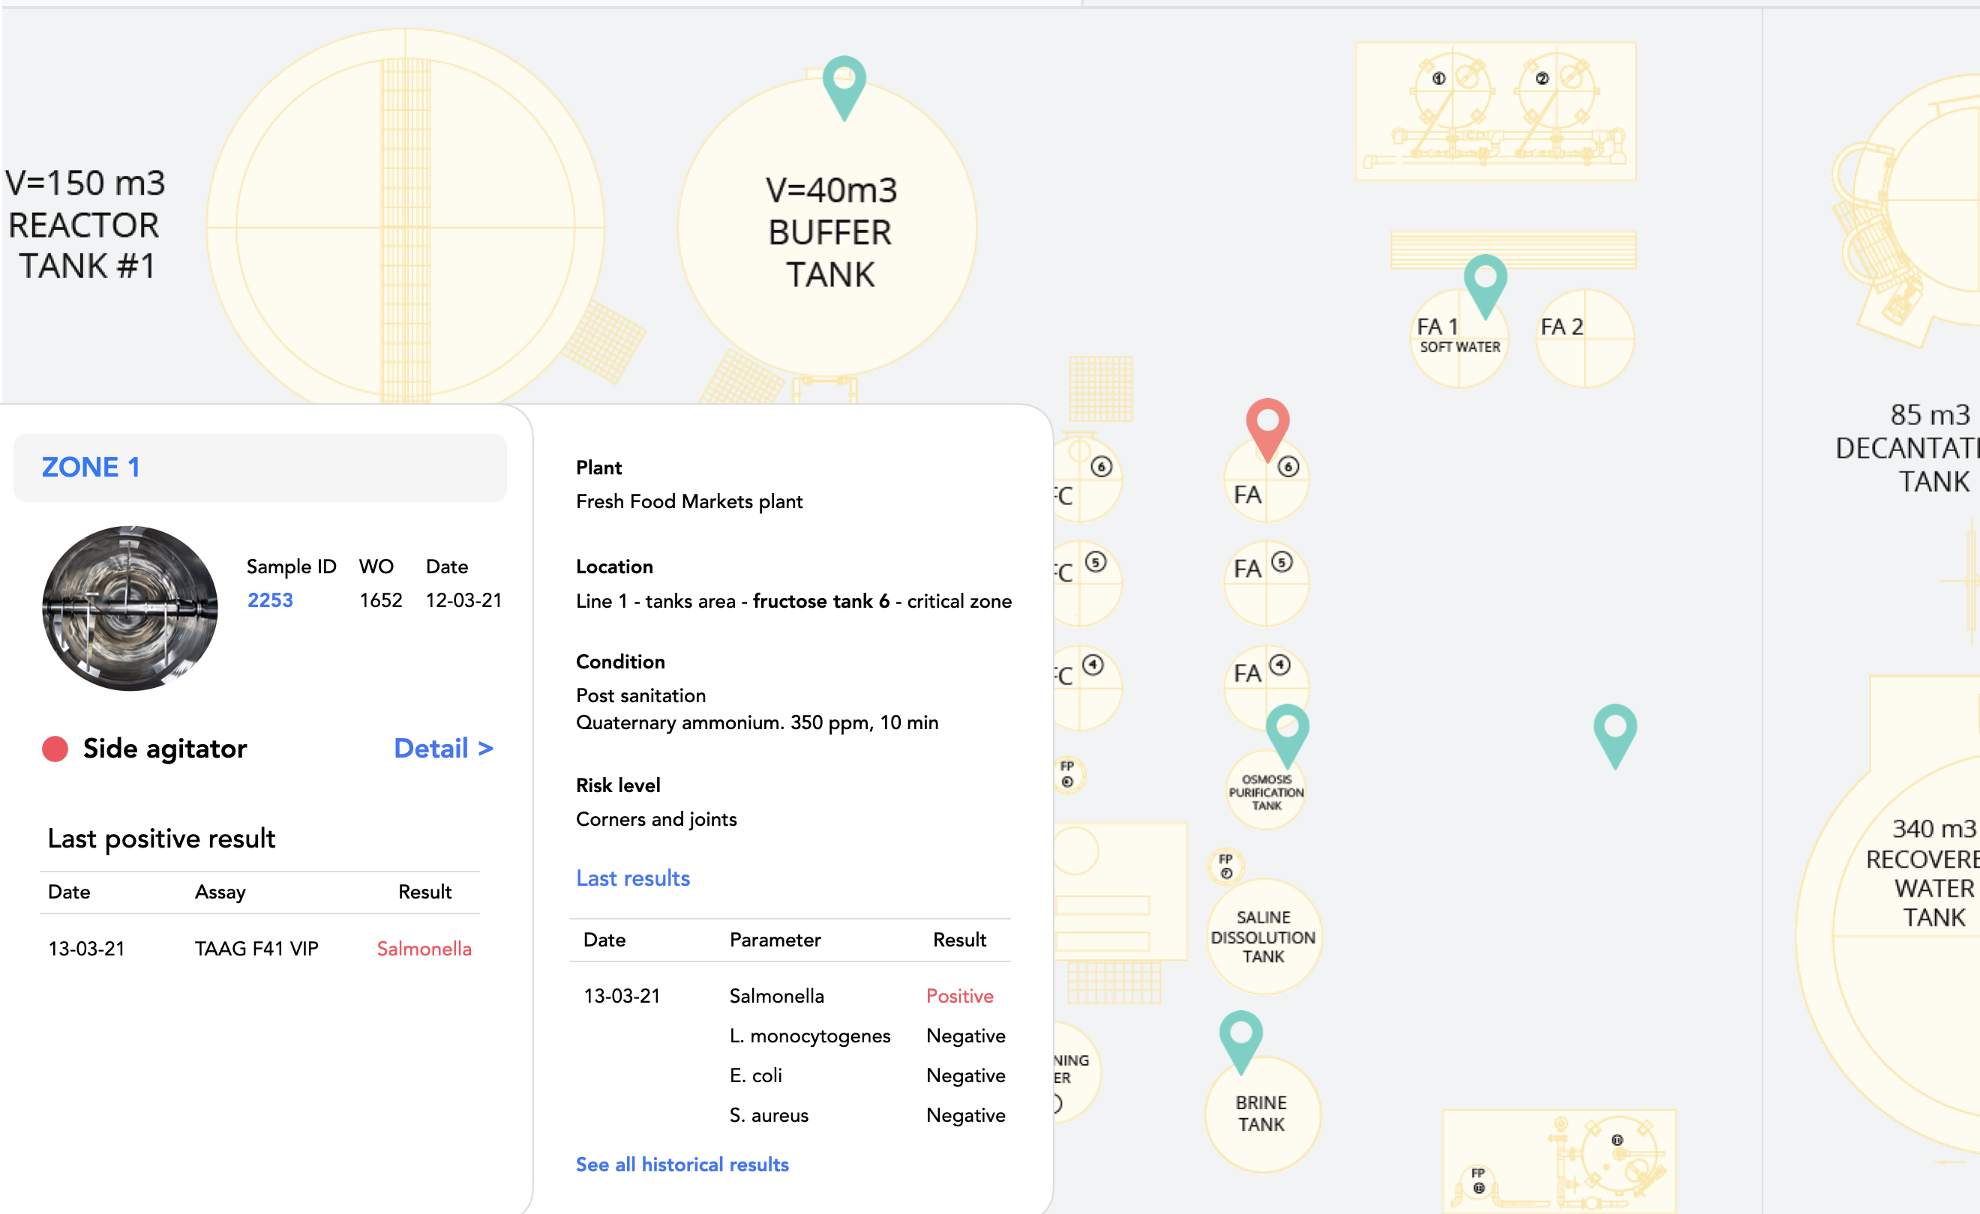

Slide 32


Slide 33
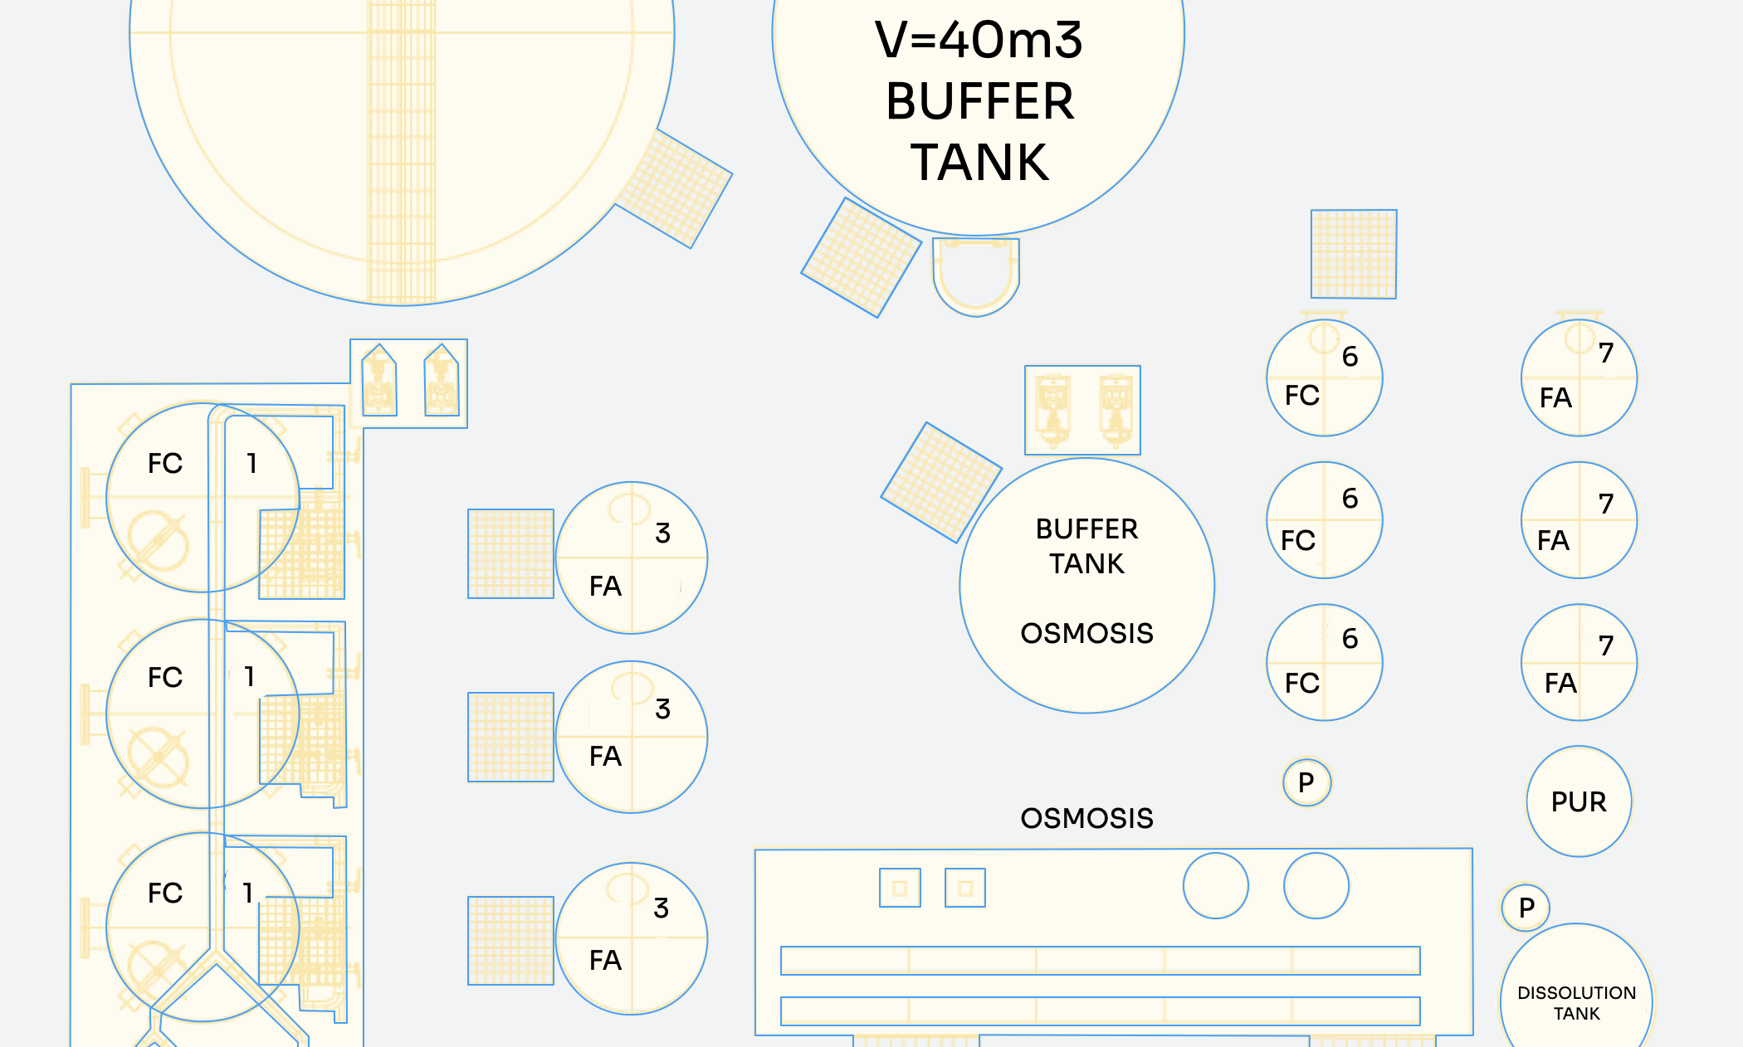

Slide 34
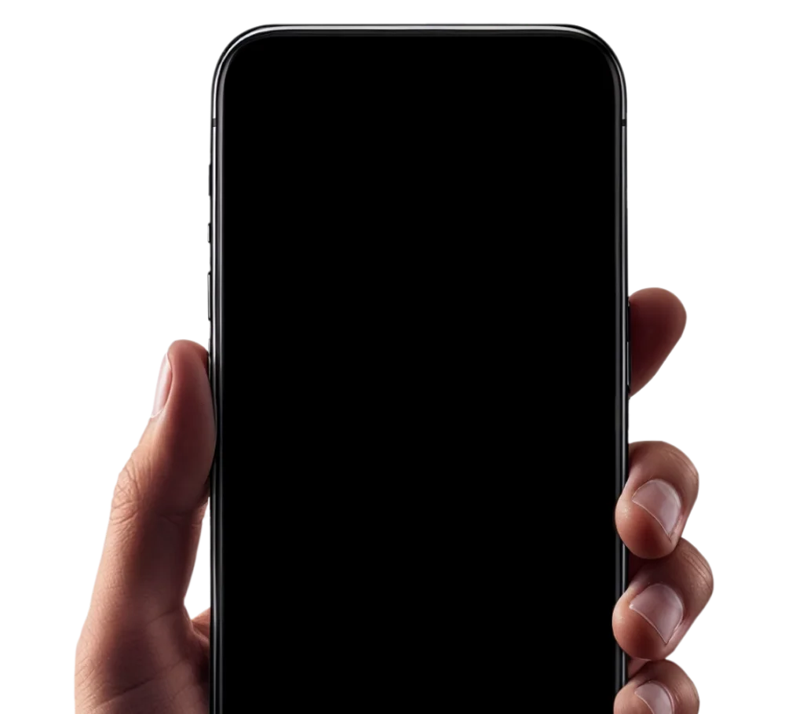
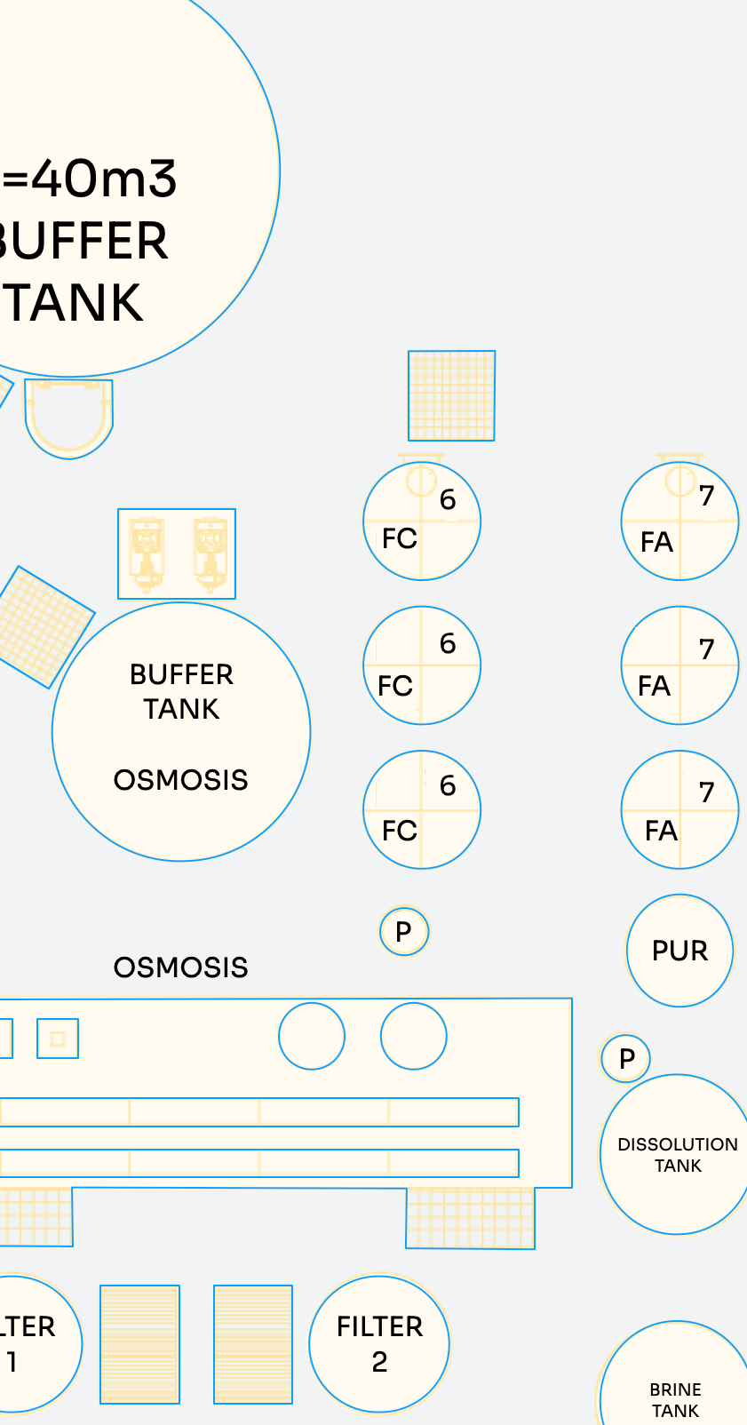



Slide 35
